Slide 1
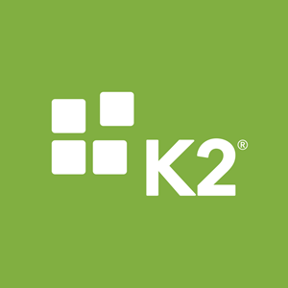

Notes:
Peace be upon you...
Introducing Elm company has been linked to the innovation of a digital-based future for a number of reasons:
Elm 3.0 Strategy through which the company will launch integrated digital solutions in all its activities.
This trend is the global trend now, after increasing the new business models that changed the concept of the market into digital transformation.
Emphasizing that Elm will maintain its leadership by providing digital solutions based on the latest technology, which is the digital transformation throughout all the stages of the customer experience.
Emphasizing that Elm provides the latest technology solutions to its customers.
Showing that we are investing in the opportunities that support Vision 2030 and the Digital Transformation Program 2020.
Obtaining more information after satisfying the customer.
This slide prepares for the next slide (a short film about the global trend) and Elm‘s future trend towards digital transformation.

Slide 2




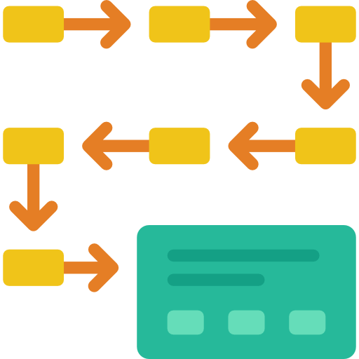
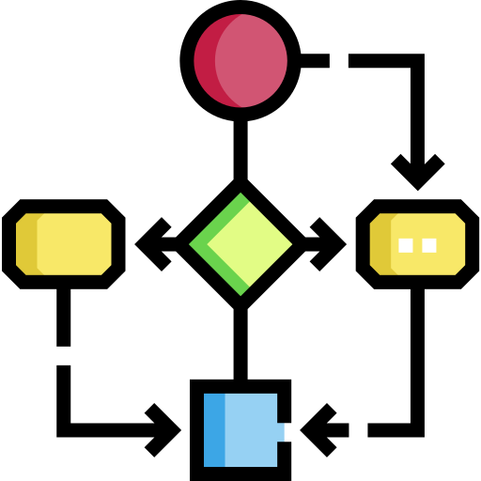
K2 usability
K2 provides you design and build forms.
K2 helps you build business process.
K2 has unlimited steps on workflow.
K2 is a platform used to build and run business application.
Out-of-the-box integration with enterprise systems.
K2 based on ASP.net development.
You can do any customizations to your forms and workflows.
Black-pearl is the previous version of k2.
In action k2 has flexibility to do any action you want if it’s fit with your business.

Slide 3
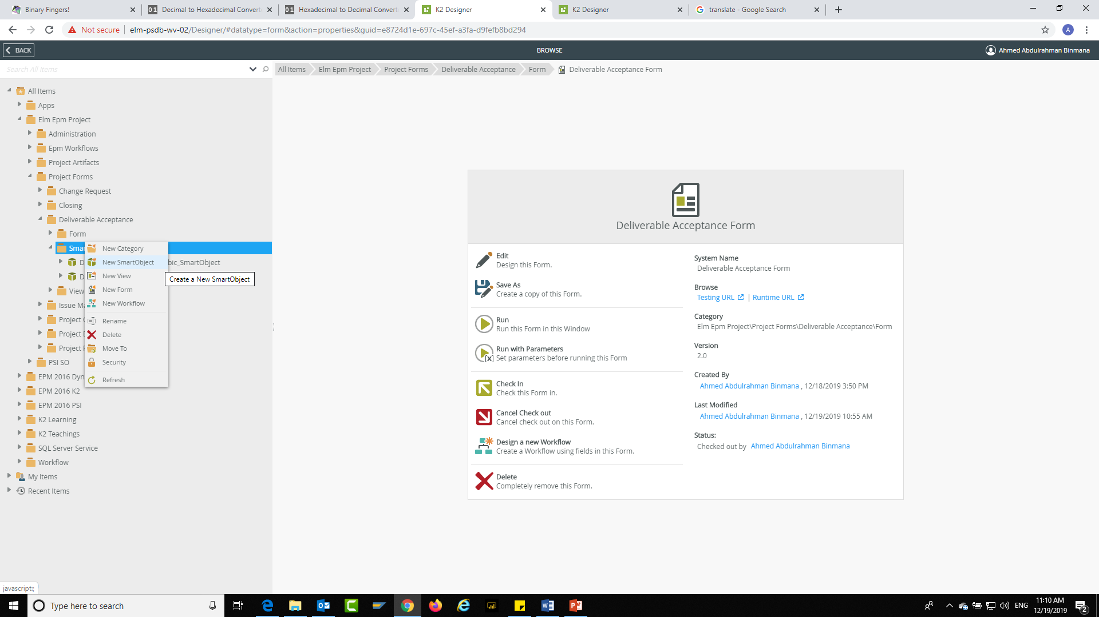
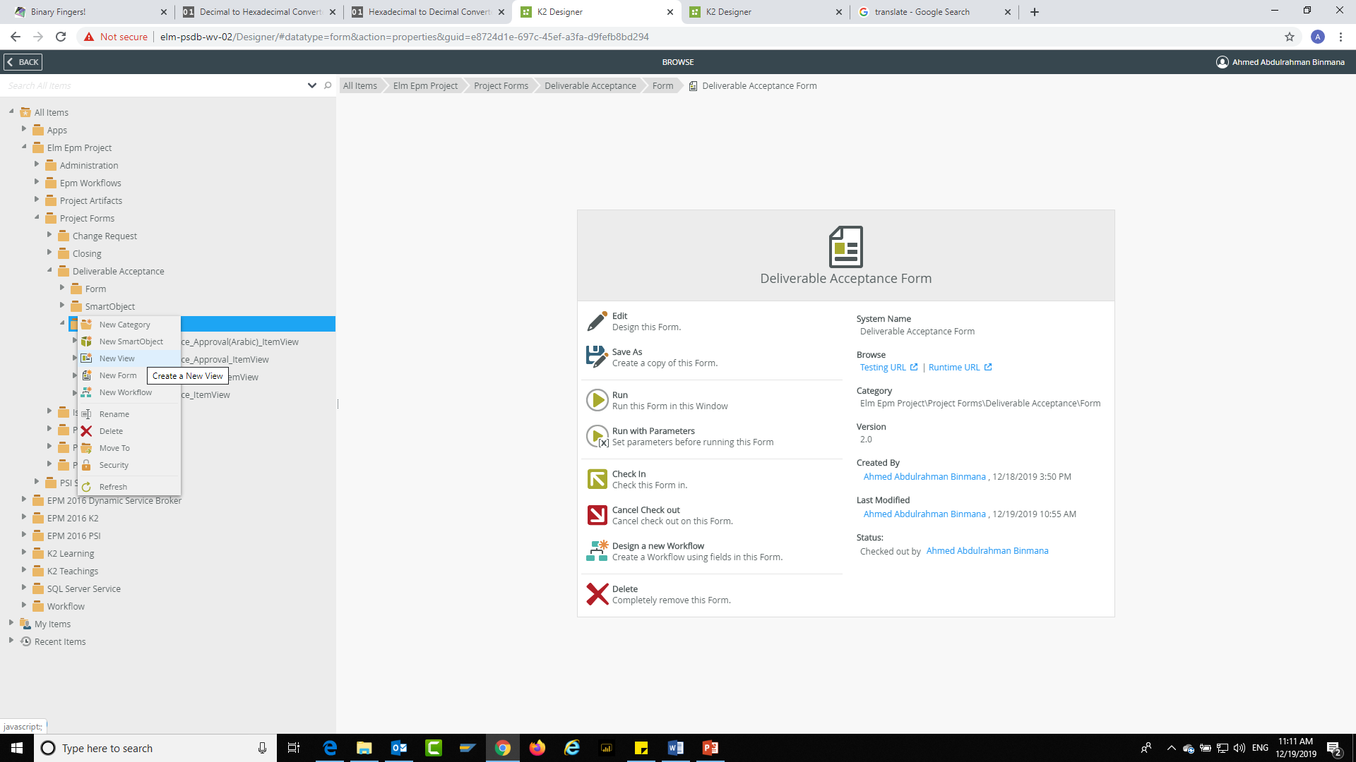
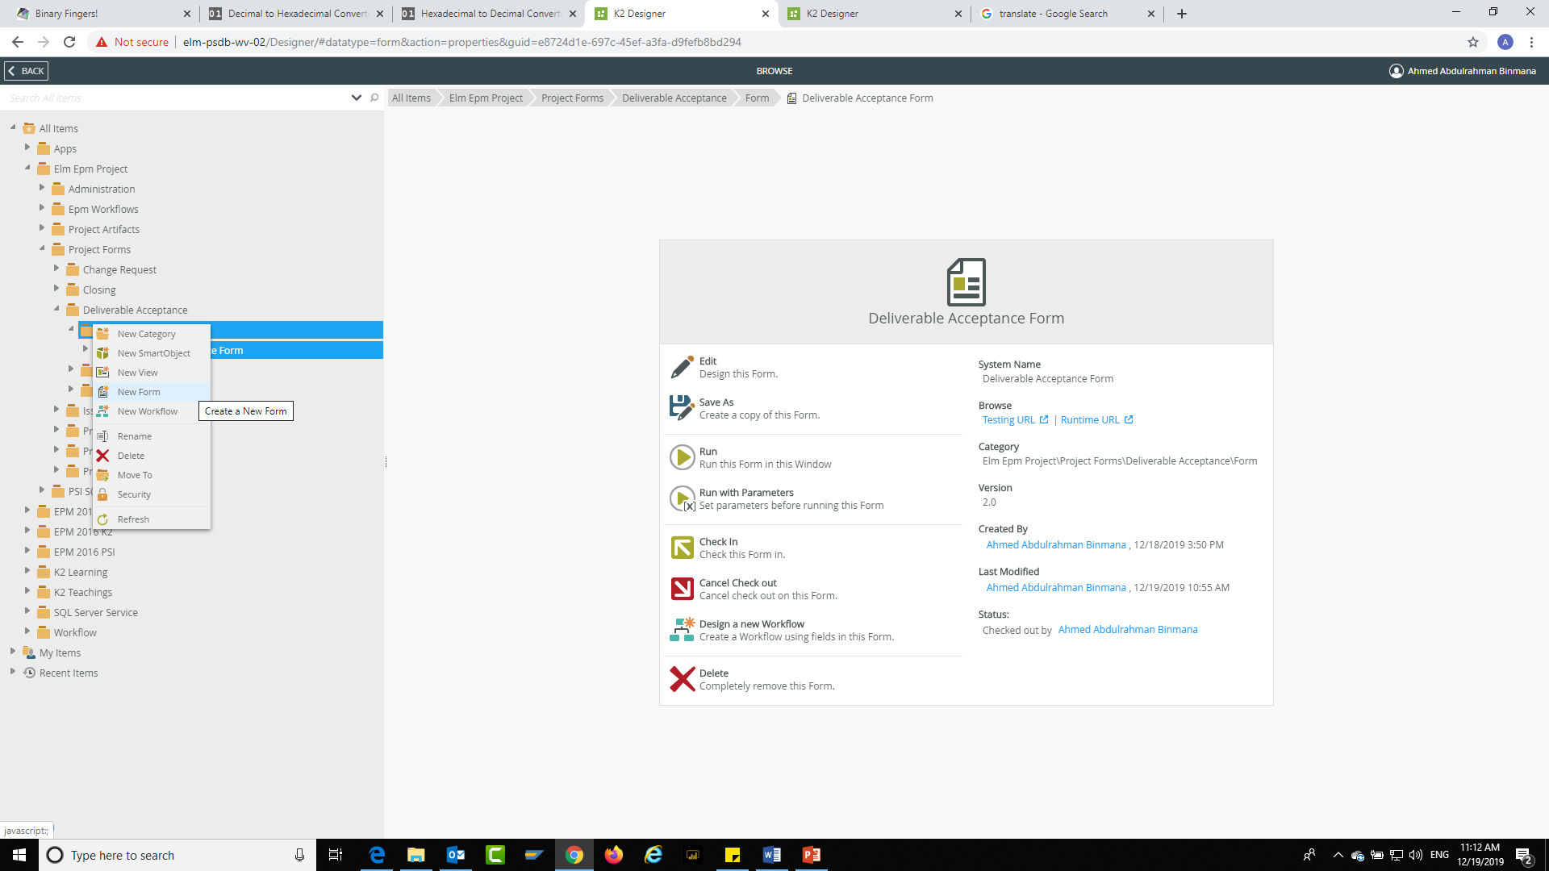
K2 Mechanism
Create a smart-Object.
Build a View.
After that you should composing the smart-Object on the view.
Build a Form to collect the View and composing it on the form.
Then if you have to link the form with the workflow, you have to build the workflow.
1
2
3
4
Smart Object
View
Form
Work
flow
1
2
3
Smart
Object
Advance
Smart
Object
Item View
List View

Slide 4




K2 Build Forms
When you build a form the most important things you should to know “Where you will store your Data?”.
How to store the Data?

Slide 5


K2 Build Forms
On K2 we can store our Data in the Smart Object, but what is the structure of our data and how we want to store our data.
Before you store your data you have to know how to Import and export your data from the data base of k2.
Structure Of Data
Store Data

Slide 6
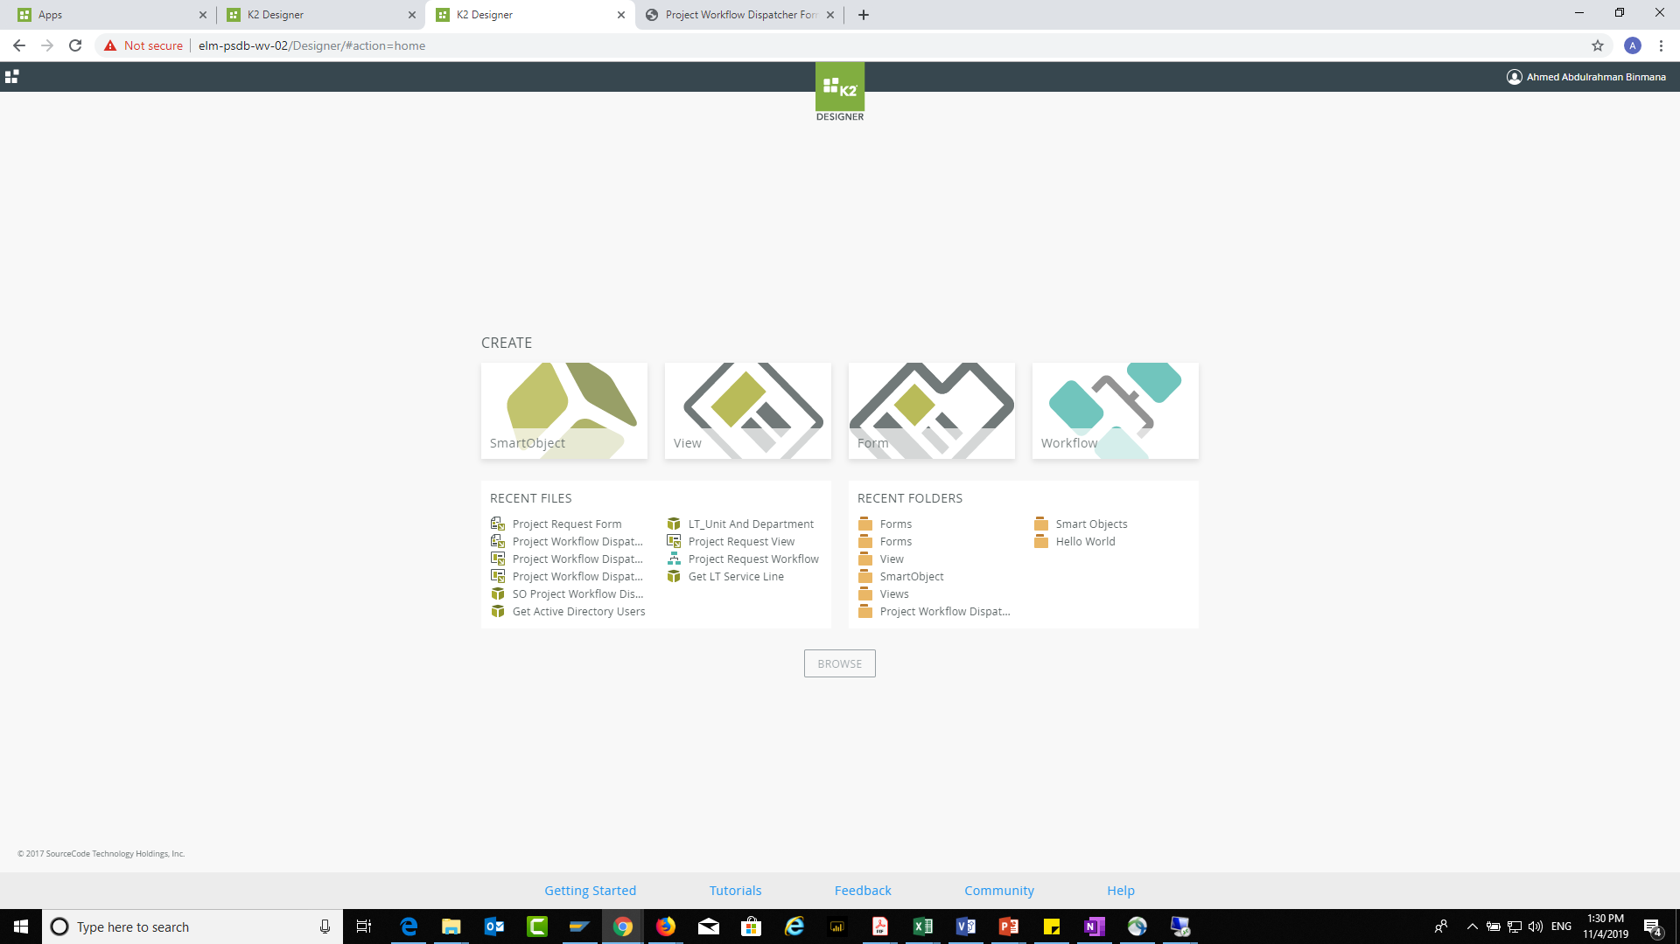
To Create a smart Object Click on “SmartObject”

Slide 7
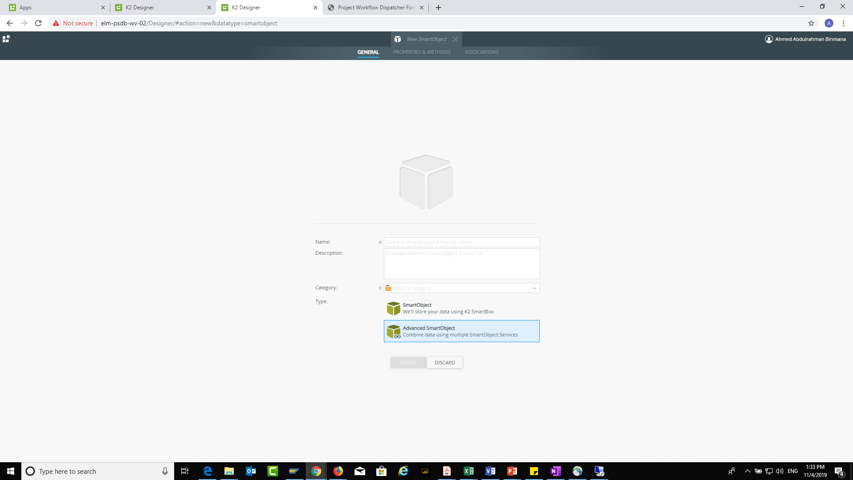
To Get Any data from out side the K2 you should make the smart object “Advanced SmartObject”
Here you have know that, from where
you will import your data

Slide 8
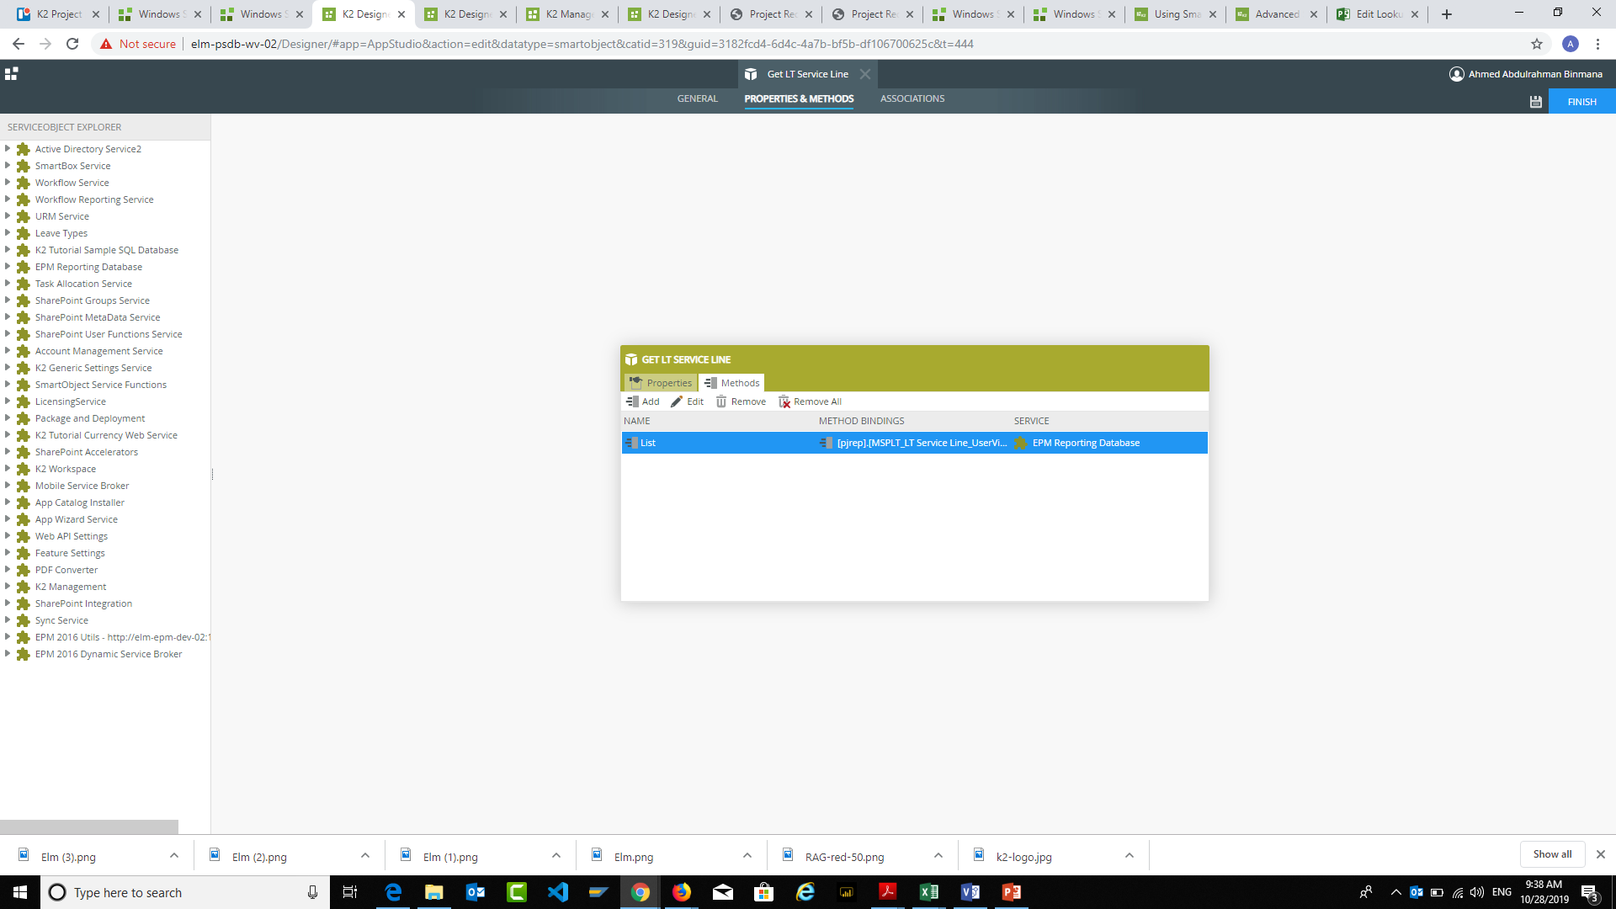
Double click on the “list”
Notes:
We start here by quickly introducing the most important phases that the company has passed by:
1986: We started as a research company for the National Information Center with the purpose of providing the best technical practices in the world and technology localization.
2002: We worked with the General Directorate of Passports to build secure electronic business, where we provided the exit and return visa. The work was limited to the Ministry of Interior sectors.
2007: The Royal Decree of King Abdullah, may Allah have mercy on him, was issued for transferring Elm into a joint stock company owned by the Public Investment Fund. After that, our services expanded.
2011: We launched our strategic plan to expand beyond e-business where we started working on:
Providing government outsourcing services: The operation of model Civil Affairs centers was the first project we launched, which achieved great success and was followed by services to all ministries and the private sector.
We also began to provide security training services.
2018: We moved to digital transformation through a clear strategy that keeps pace with the latest in digital technology in the world.
We can introduce the next slide with the following: "Having identified the company's growth journey, we move on to focus on the customer's journey as it is the most important aspect in our business and around which the Elm 3.0 strategy revolves ."

Slide 9
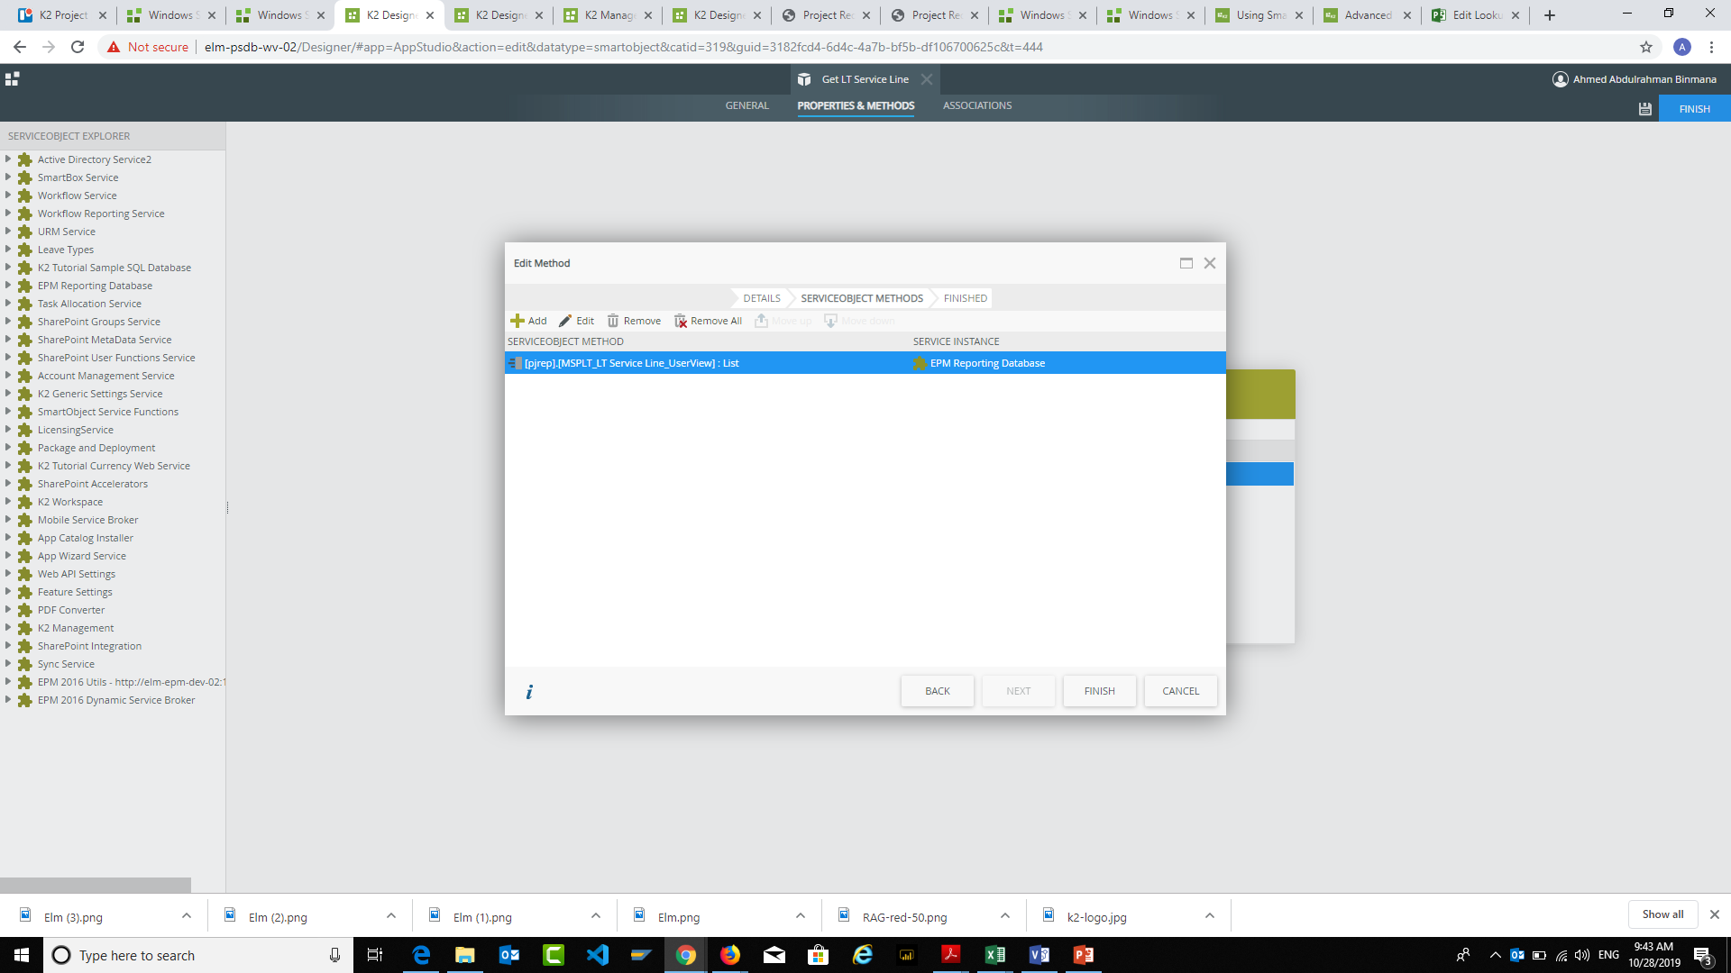
Double click on the “list”

Slide 10
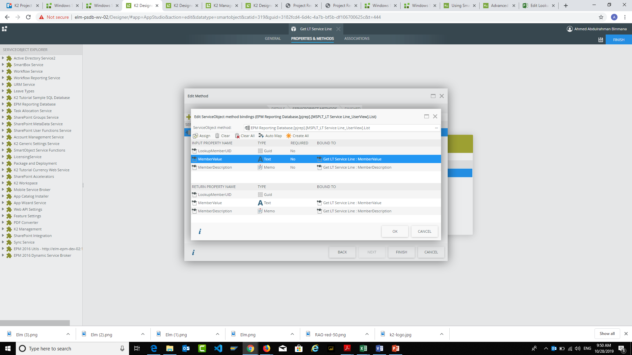
If you find “Auto Map” blank just click on the “Create All” Then Click ok don’t go to next step

Slide 11
1
Select the “INPUT PROPERTY NAME” then “Assign”

Slide 12
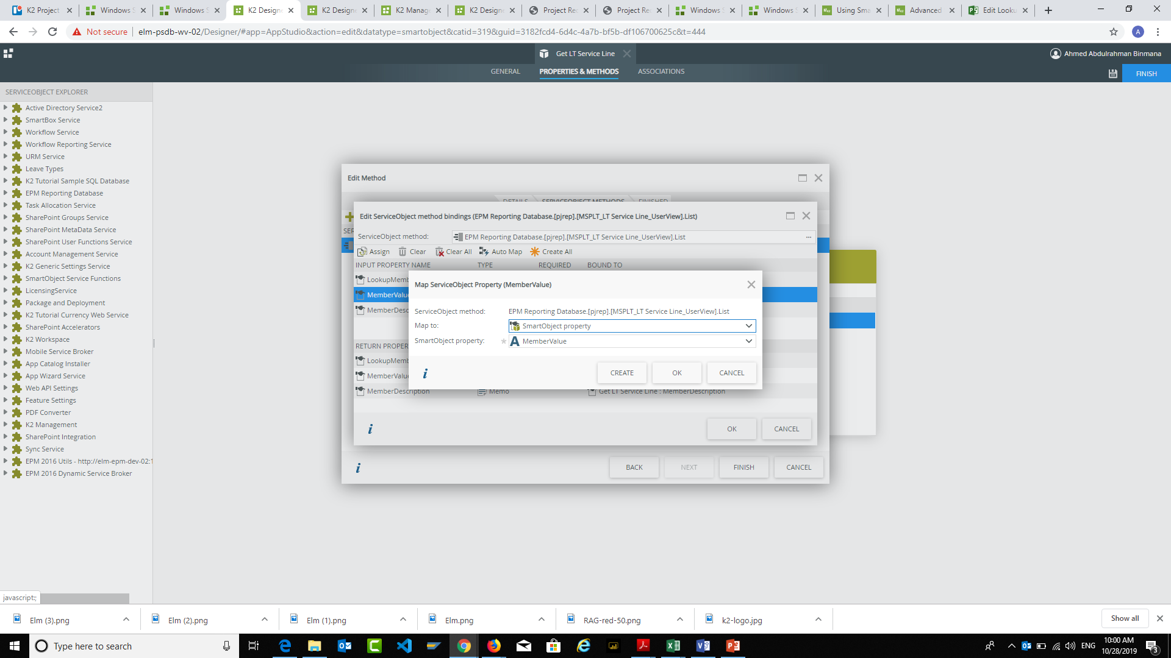
You should map it to SmartObject property

Slide 13
To Test The integration
Notes:
Peace be upon you...
Introducing Elm company has been linked to the innovation of a digital-based future for a number of reasons:
Elm 3.0 Strategy through which the company will launch integrated digital solutions in all its activities.
This trend is the global trend now, after increasing the new business models that changed the concept of the market into digital transformation.
Emphasizing that Elm will maintain its leadership by providing digital solutions based on the latest technology, which is the digital transformation throughout all the stages of the customer experience.
Emphasizing that Elm provides the latest technology solutions to its customers.
Showing that we are investing in the opportunities that support Vision 2030 and the Digital Transformation Program 2020.
Obtaining more information after satisfying the customer.
This slide prepares for the next slide (a short film about the global trend) and Elm‘s future trend towards digital transformation.

Slide 14
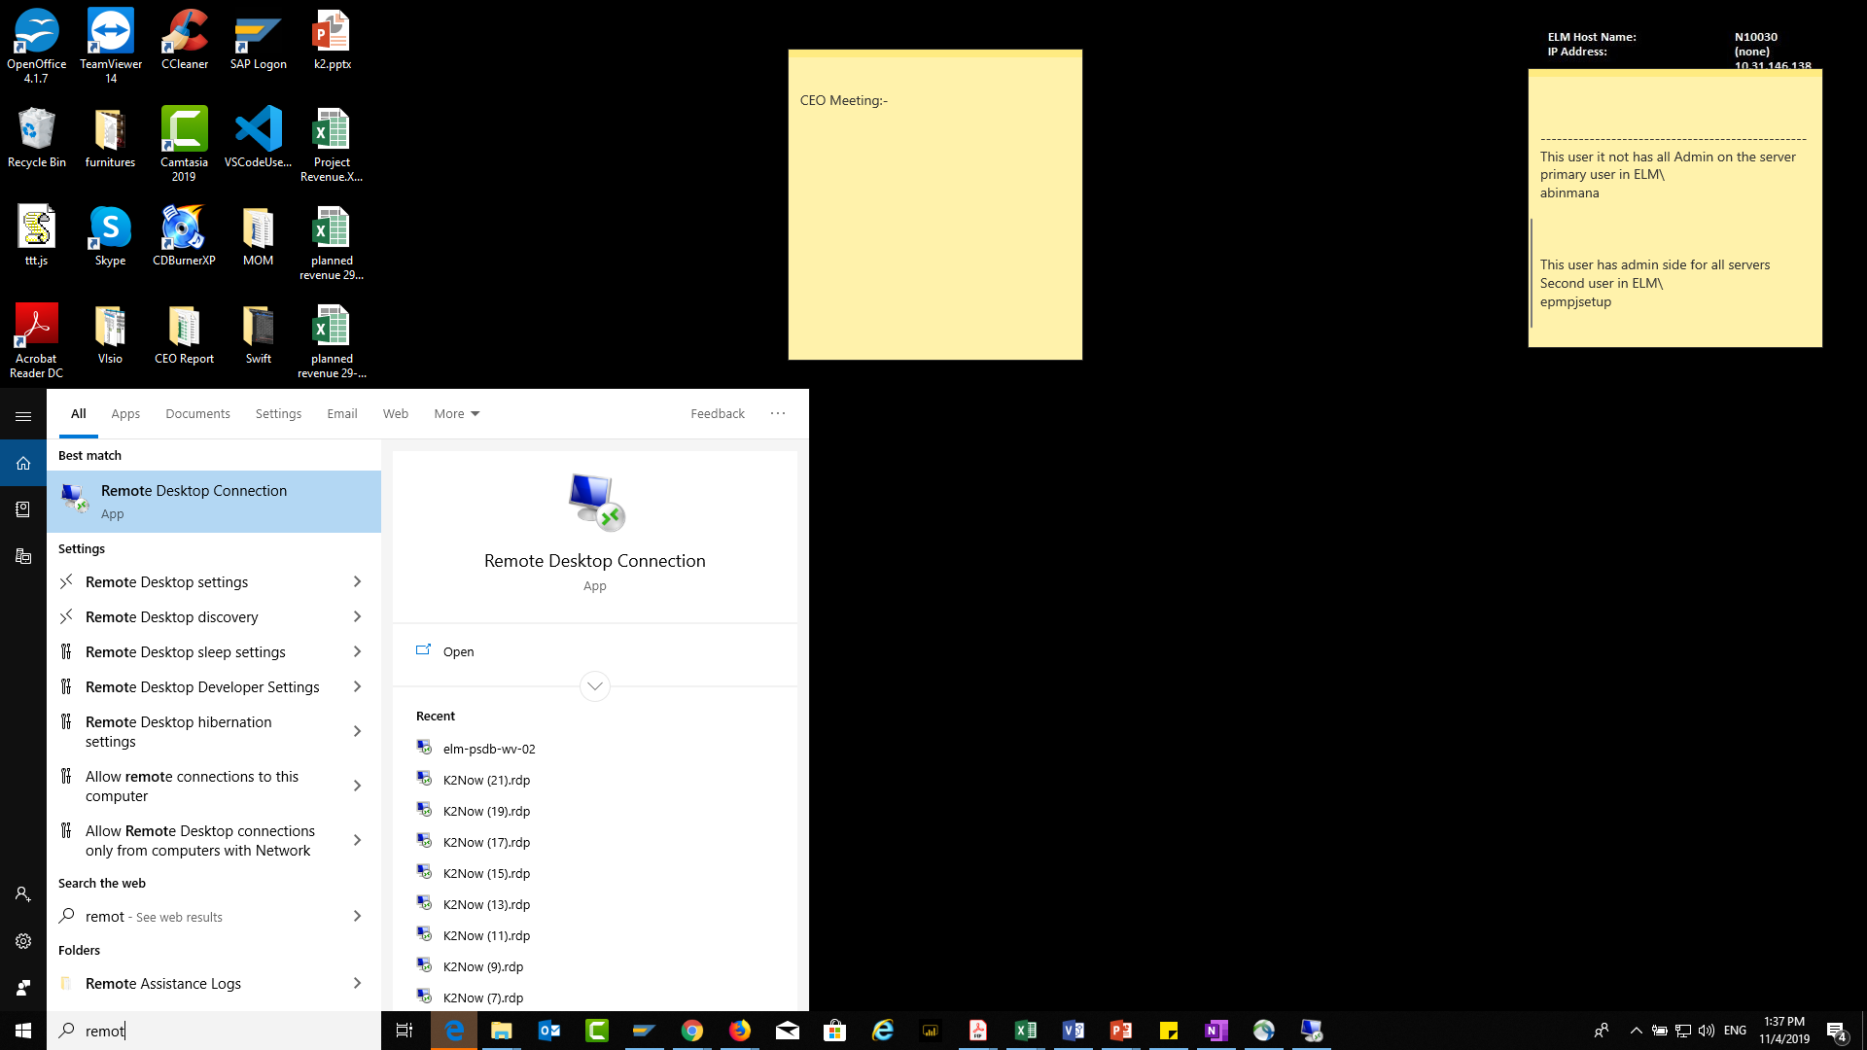
To test it you should open the Remote Desktop Connection

Slide 15
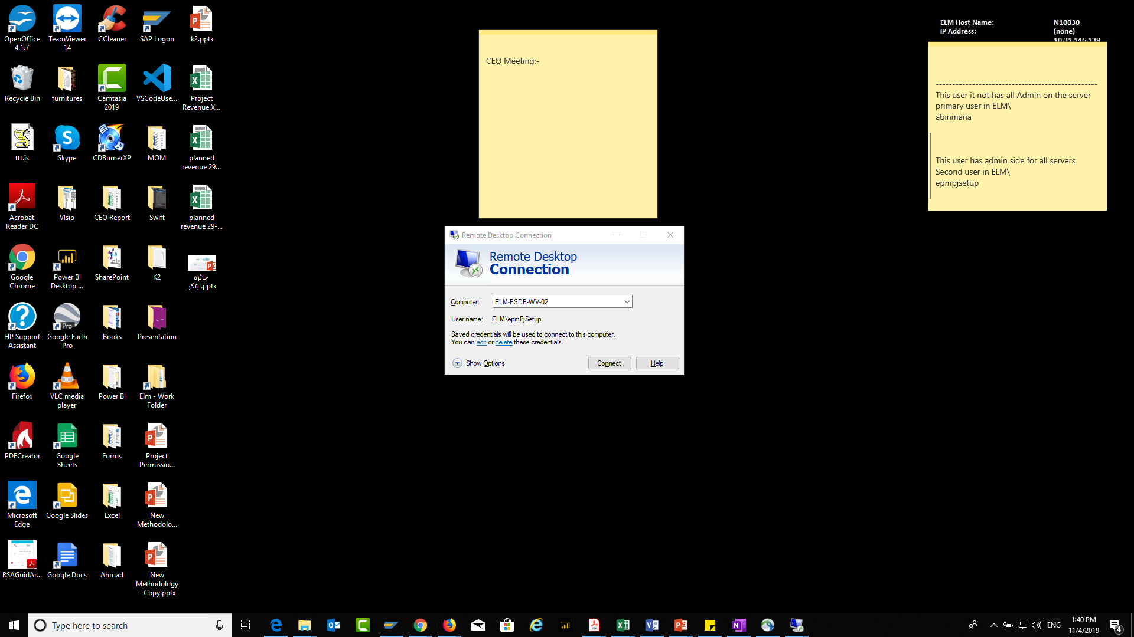
You Should Open This Server

Slide 16
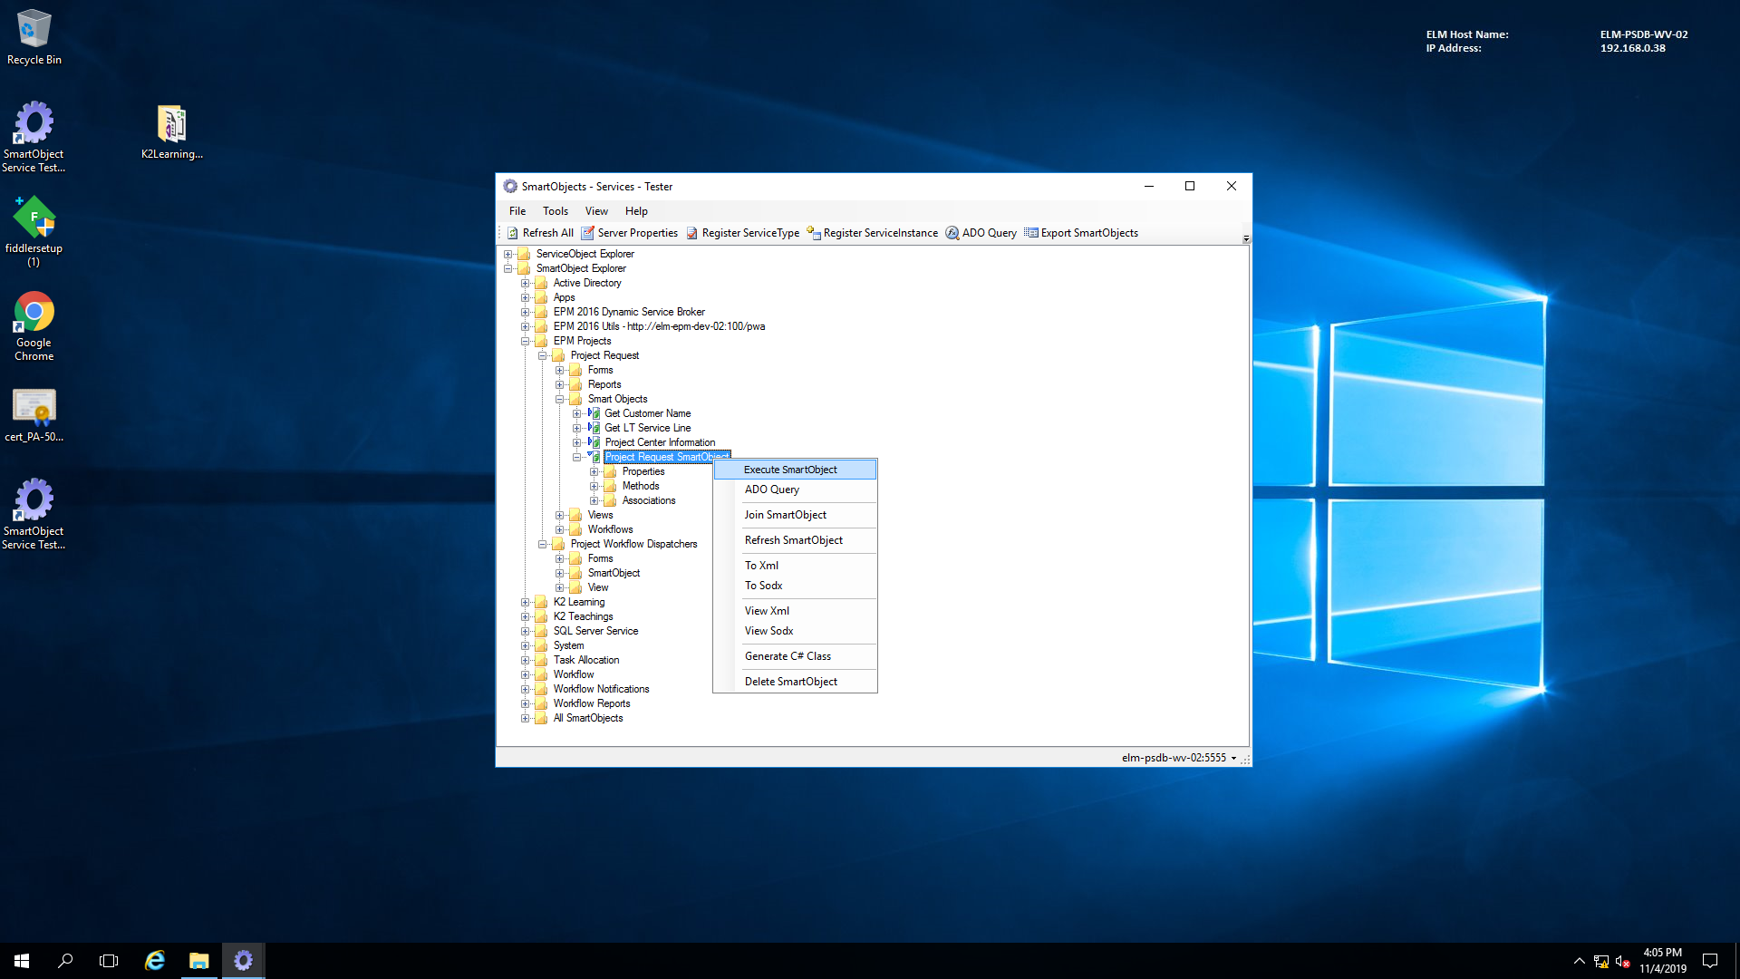
You Should open the SmartObject Servicer
Here you should find the folder that contain the smart object you create it
Then click on “Execute SmartObject”
1

Slide 17
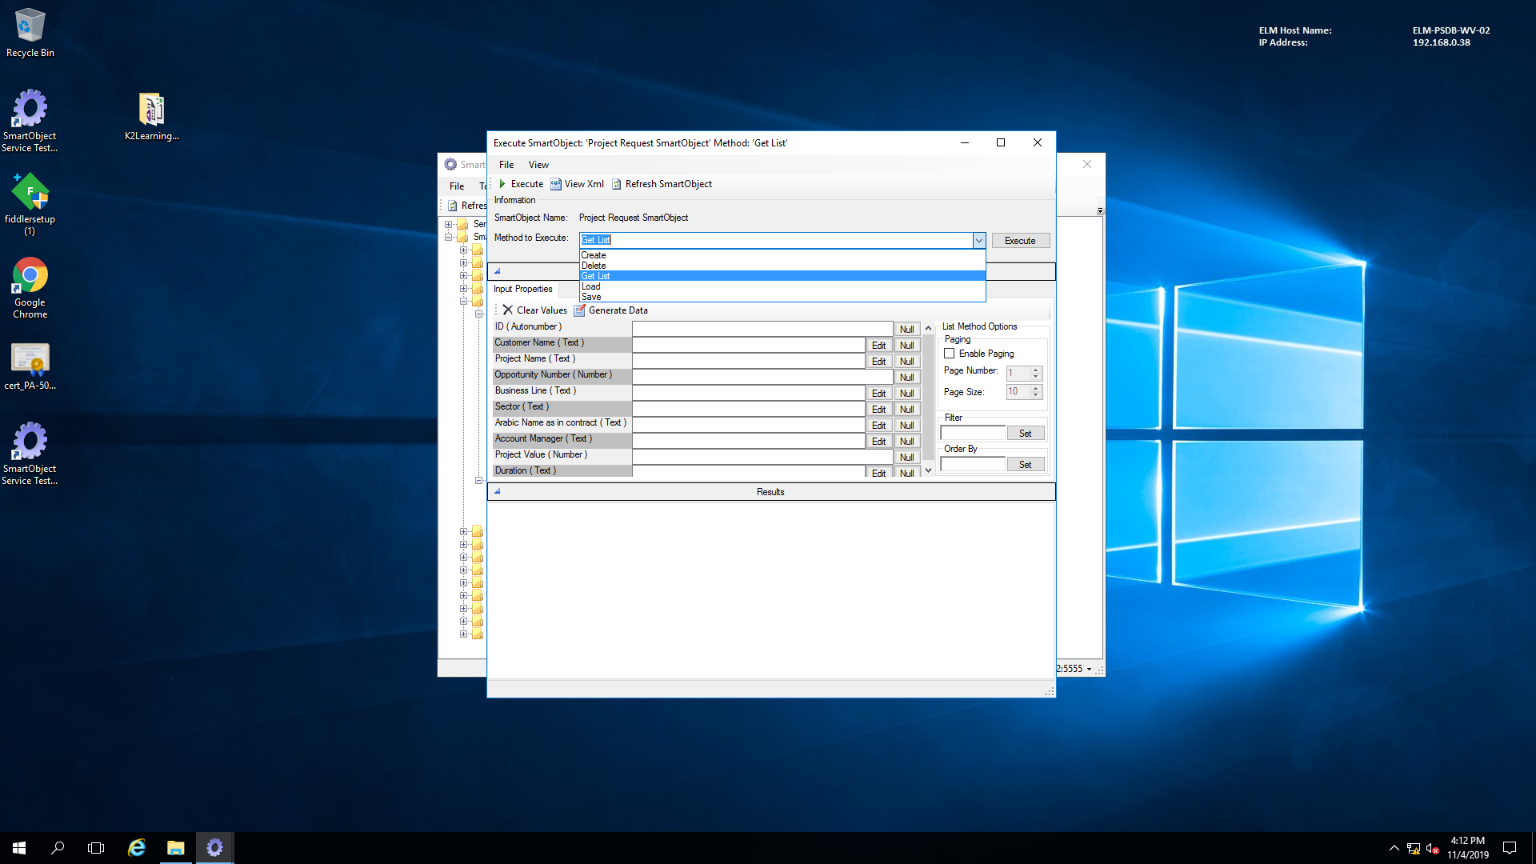

Slide 18
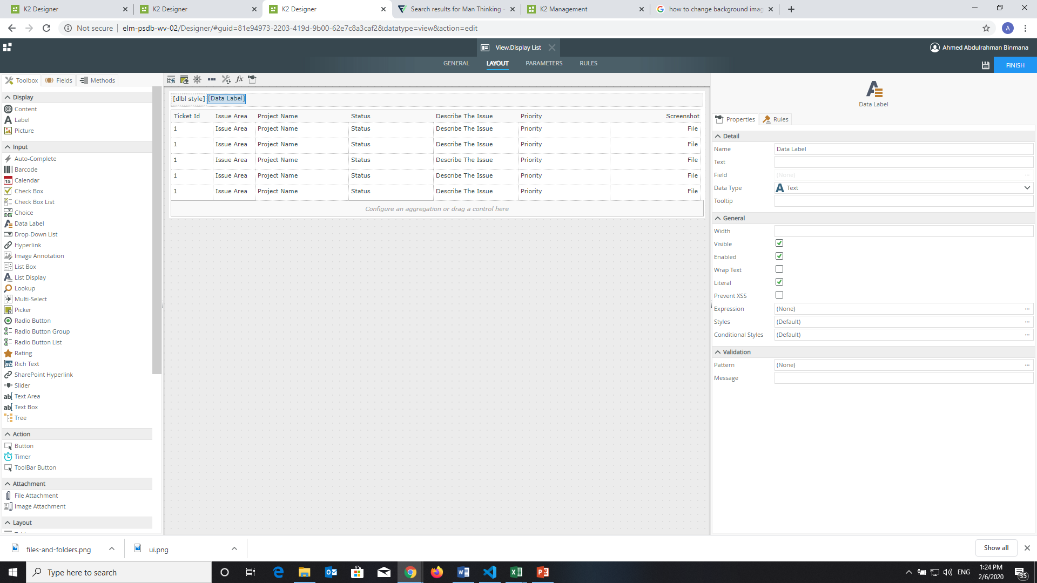
K2 Design Item in the form
You should add the Data label then you should check the
“literal” in General and make the Prevent XSS uncheck.

Slide 19

K2 Design Item in the form
Here you should open the
”Expression” to connect you style

Slide 20
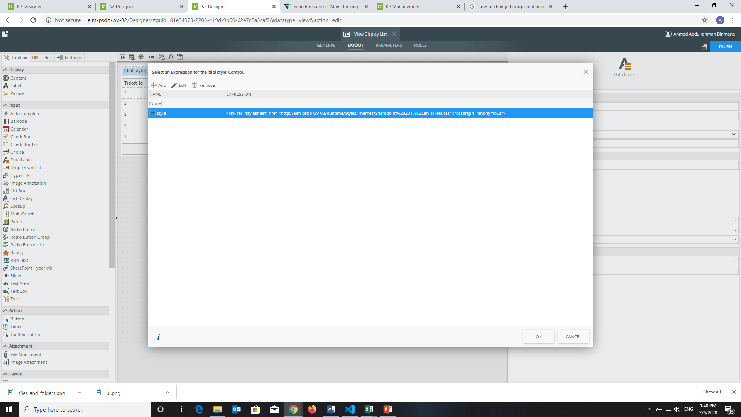
K2 Design Item in the form

Slide 21
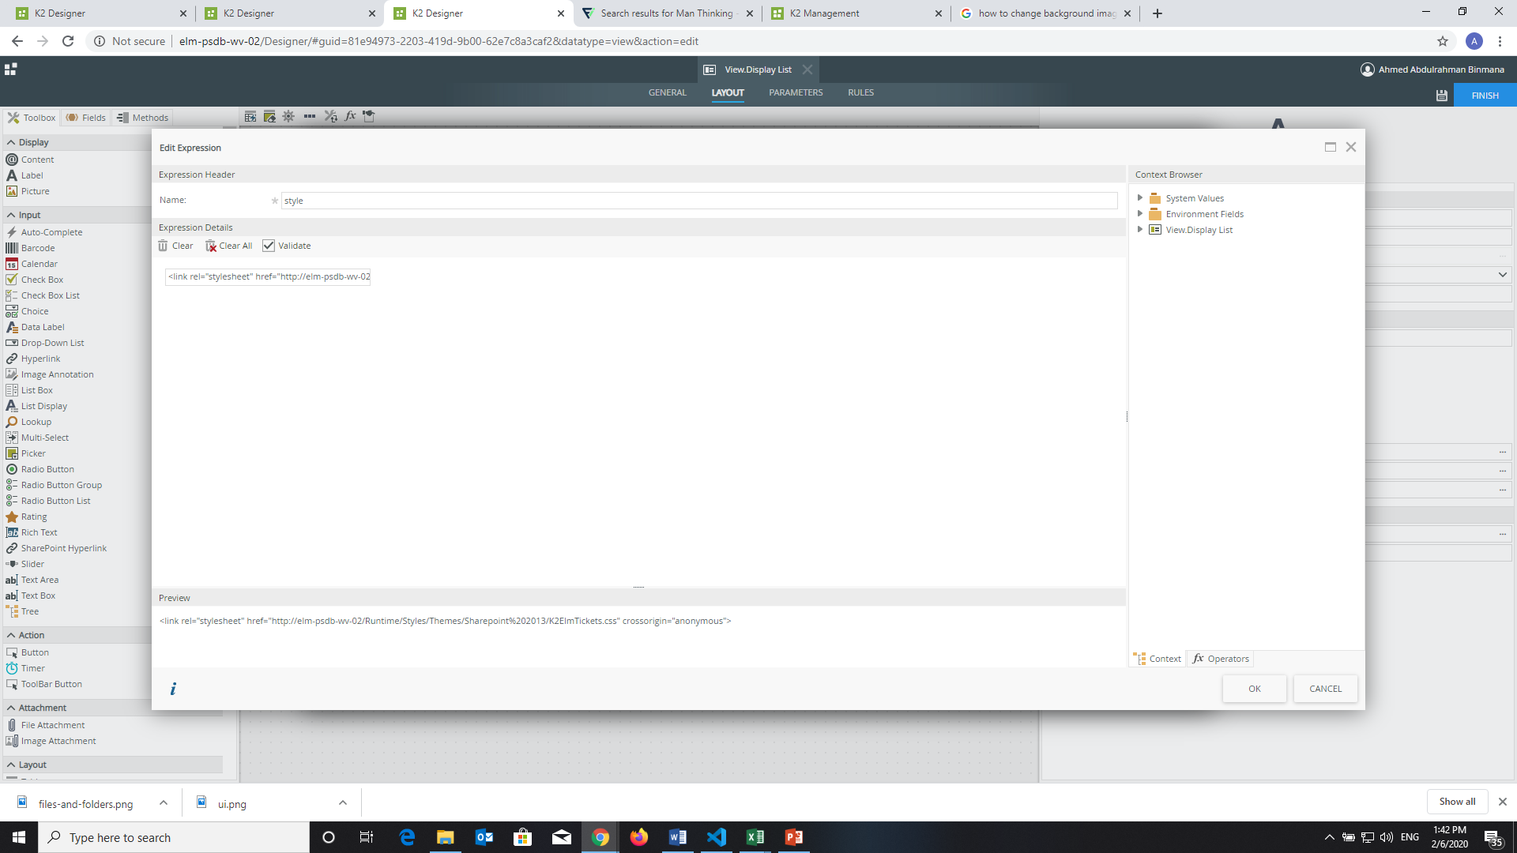
K2 Design Item in the form
Here you have to name it
Here you have to paste the path of your style
EX:<link rel="stylesheet" href="http://elm-psdb-wv-02/Runtime/Styles/Themes/Sharepoint%202013/K2ElmTickets.css" crossorigin="anonymous">
We are save our style in here http://elm-psdb-wv-02/Runtime/Styles/Themes/Sharepoint%202013/K2ElmTickets.css

Slide 22
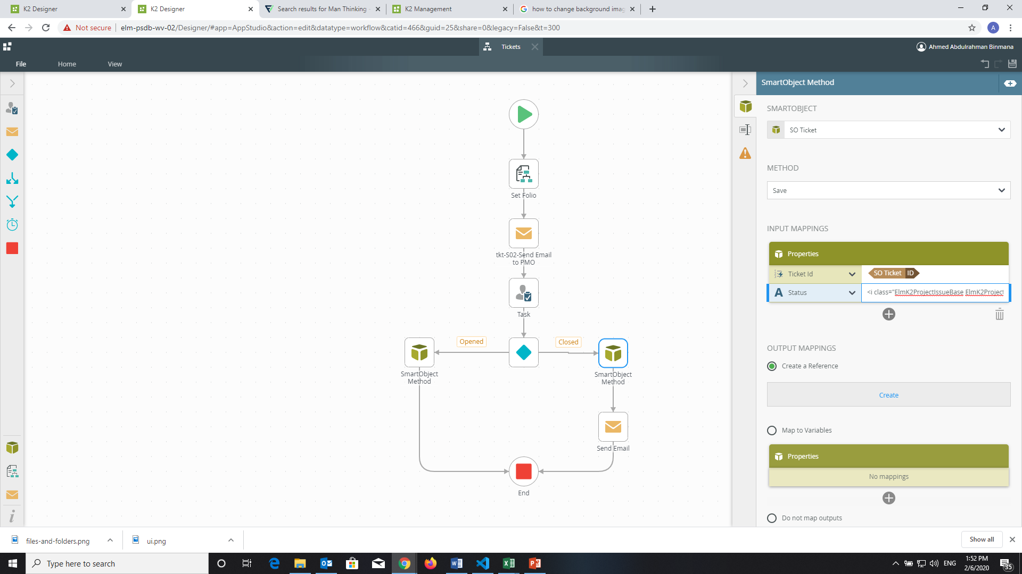
K2 Design Item in the form
In the “properties” you have to add the Ticket ID and
the Status and you have paste the style in the Status
You have to click on the object

Slide 23
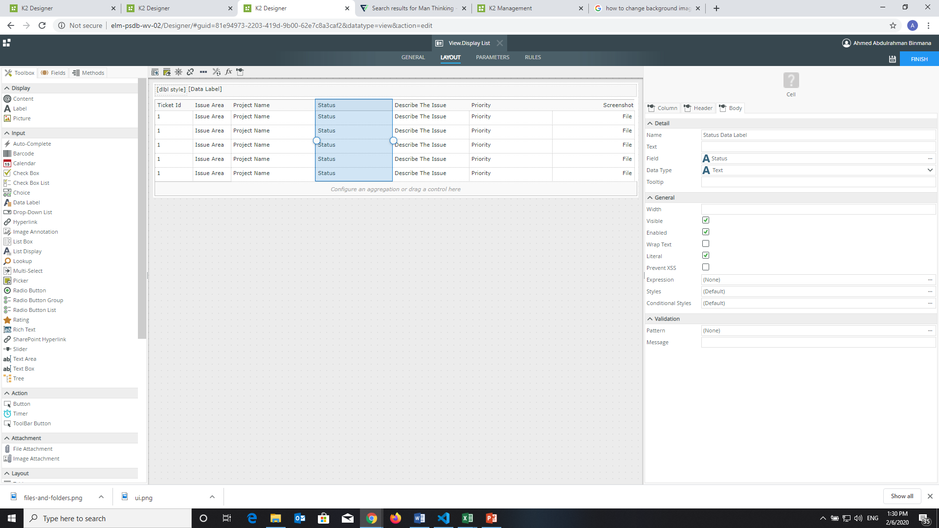
K2 Design Item in the form
As well you should choose here in the column you
want the design effect on, you must to choose

Slide 24
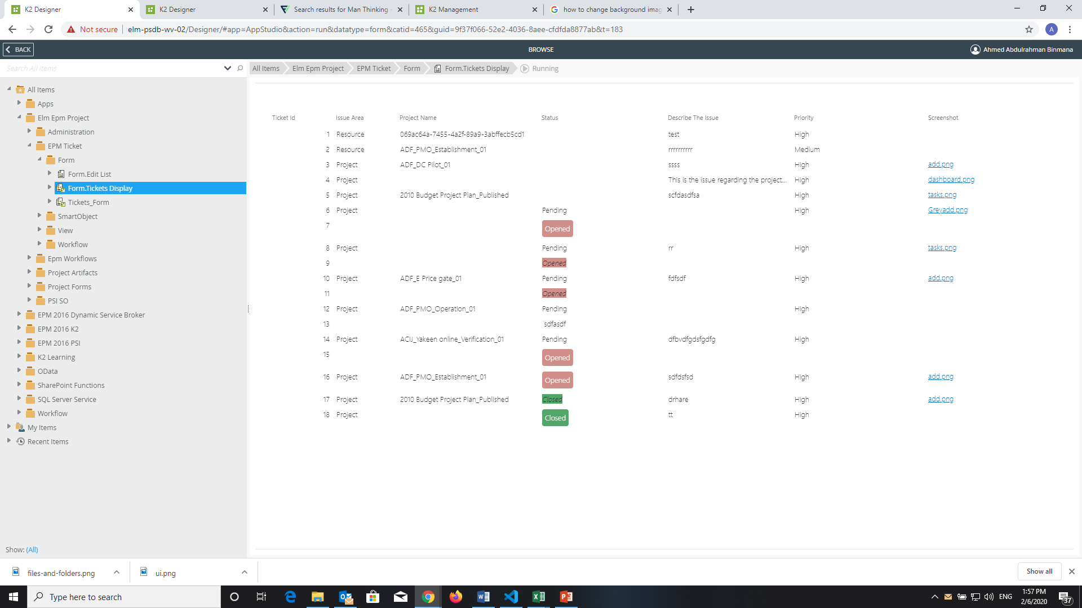
K2 Design Item in the form
This is the end Result

Slide 25
Issues on The System

Slide 26
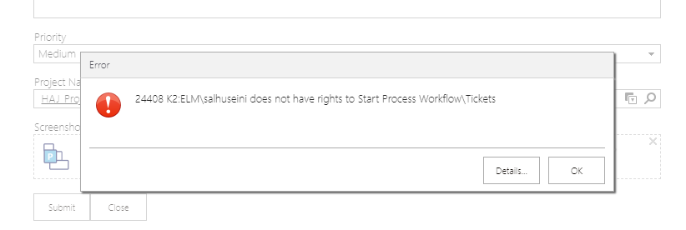
If user Dose not have rights
This issue when the user want to submit the request to start workflow

Slide 27
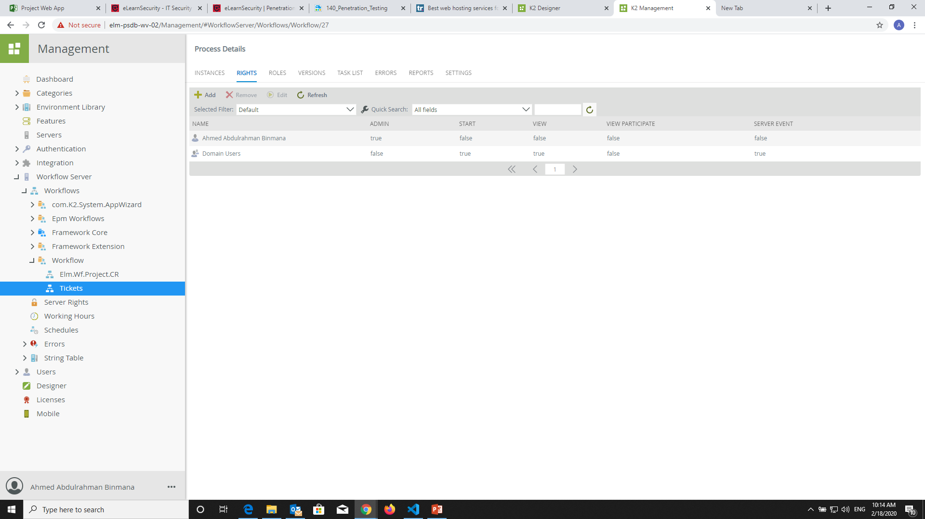
Solution
1-You have to open your workflow.
2-then you have to click on the “RIGHTS”.
3-You have to click on “Add”.

Slide 28
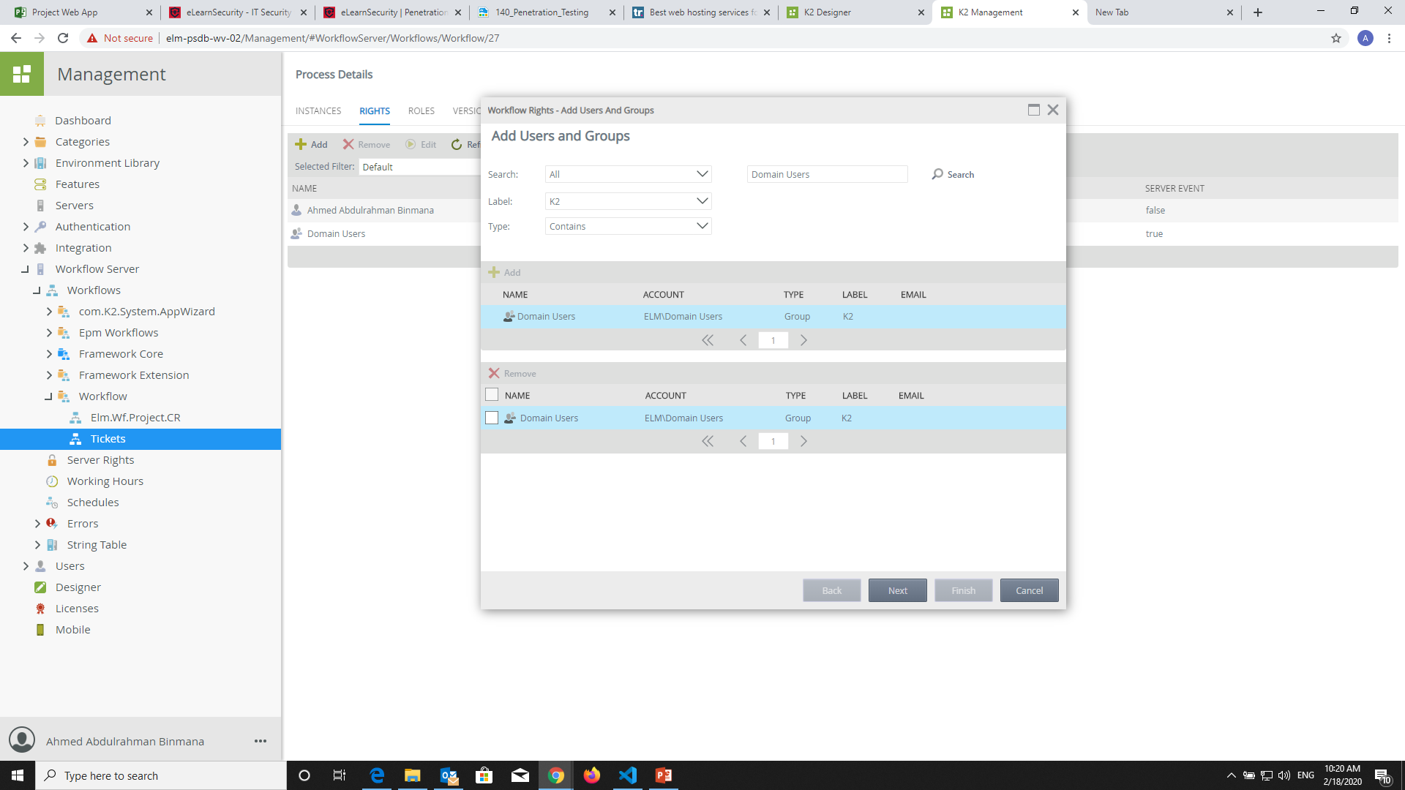
Solution
1-Here you have to select on search”All” and search about “Domain Users”
2-Then double click on it then click Next

Slide 29
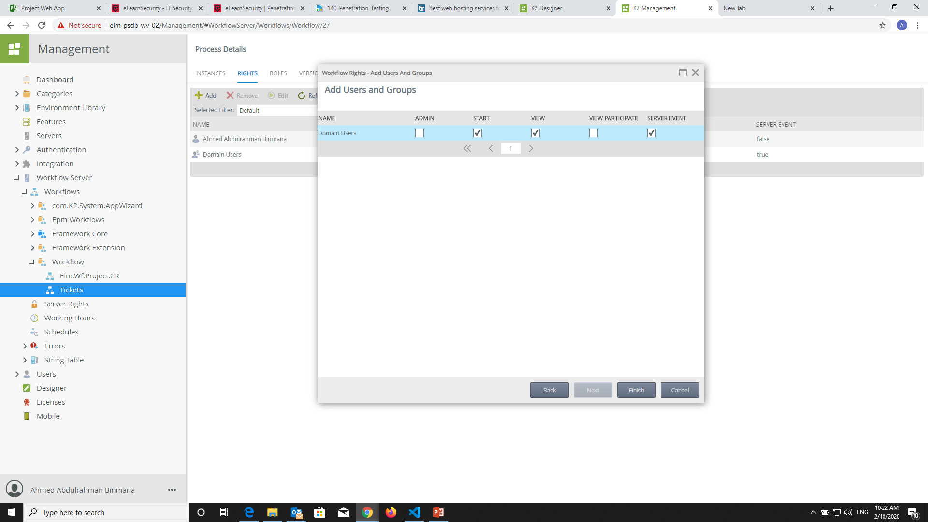
Solution
1- If you are chose all user domain this is the Rights they need.
2- then click on “Finish”.

Slide 30
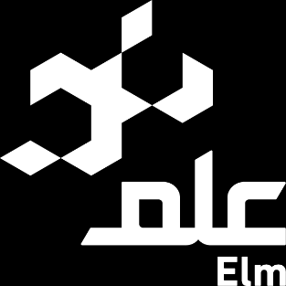
Thank you..

